Slide 1
Prior Learning Assessment
College-Level Learning

Slide 2
What is College-Level Learning? Part 1
College-level learning means that, in a particular field, you can manipulate your knowledge in some way.
For example, you can:
Think critically about concepts
Apply concepts to multiple scenarios
Analyze information
Evaluate information
Synthesize information – put multiple pieces of information together and understand how your viewpoint compares with others’

Slide 3
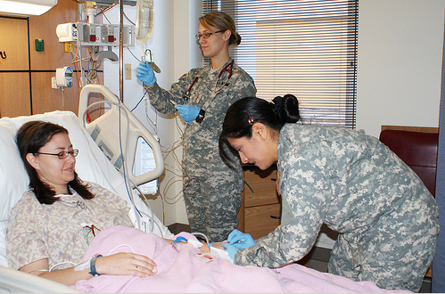
Part 2
According to Urban Whitaker, in Assessing Learning: Standards, Principles, and Procedures, learning that receives college credit should be: “learning that has a balance, appropriate to the subject, between theory and practical application.”

Slide 4
Part 3
College-level learning is NOT necessarily confined to subjects taught in college courses.
A professional dancer and choreographer might have college-level learning in Choreographing for Children, which is not a usual course in a dance curriculum.
A volunteer in a community non-profit organization may have college-level learning in volunteer coordination, which is not a usual course in a college curriculum.
College-level learning may result from many different types of personal, work, or training experiences.

Slide 5
Part 4
If your prior learning does happen to be in an academic field, you do not have to match the syllabus of a college course exactly.
You do have to show awareness of current knowledge in that field.

Slide 6
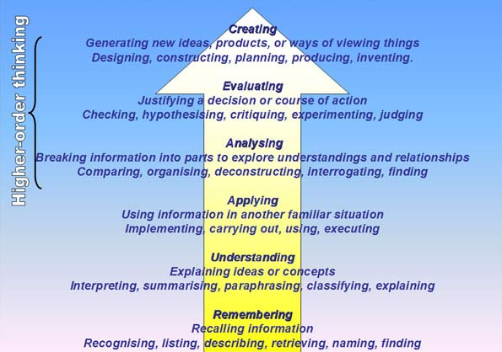
College-Level Learning & Bloom’s Taxonomy
Benjamin Bloom identified different categories of thinking skills, which you’ll see on the next slide. These thinking skills relate to college-level learning.
Lower-level or Freshman-Sophomore level learning:
Understanding
Applying
Upper-level or Junior-Senior level learning:
Analyzing
Evaluating
Creating

Slide 7
Bloom’s Revised Taxonomy

Slide 8
Consider your Learning: Is it college level?
Can you compare and critique different approaches?
Do you understand the subject in some depth?
Can you generalize from your experience to develop an insight?
Can you apply general concepts to various situations?

